Slide 1
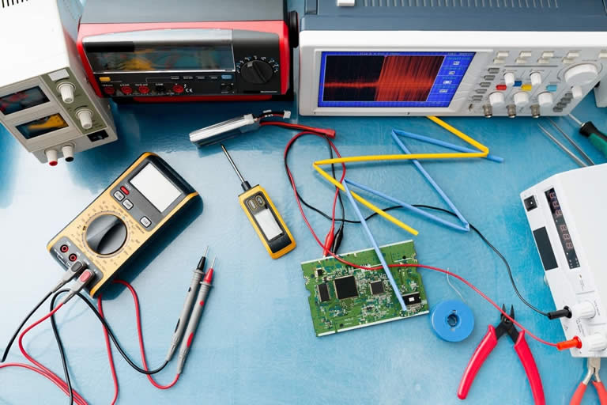
electrical Lab AUTOMATION

Slide 2
Objective
Introduction
Specification
Snapshots
Work Delegation
Brief Description
Experience

Slide 3
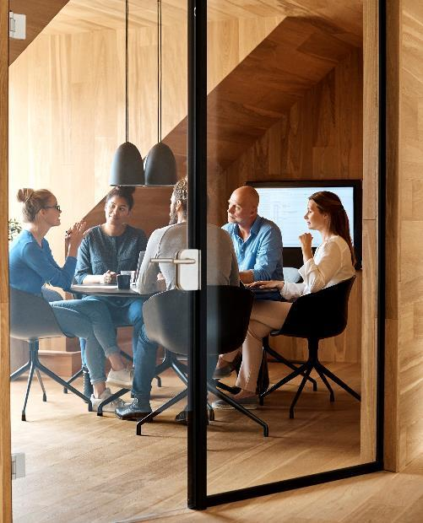
…Introduction of Team…
Student 1340184
Asher Ahmed
Student 1335819
Maryam Kashif
Student 1340171
Zubair Uddin
Student 1340161
Zoya Abid

Slide 4
Project Specification
Lab automation is a dynamic website.
User must be login first.
We have three dashboards to start with admin panel, furthermore laboratory panel inclosing company panel.
There are varieties of electrical product such as gears, resistors bulb, switches, capacitors and so on.
User can see the products and related information regarding testing and launching from company/laboratory.
User can as well add product's, delete product’s and update the product’s.
User can see the status either their product is accepted or rejected.

Slide 5

Brief description
This website is to build on following requirements.
User have an option of added or edit items or products.
If a user want to update any product so the user click on update and the product is updated according to the wish of user what he want to update any item.
User can find or search out many varieties of products.

Slide 6
time isn’t the main thing. It’s the only thing.
Login form + Images collection + Perform crud operation
Week1
ERD diagram + Database+ Logo design
Week4(start 4 days)
Build a complete company panel with its testing
Week2
Designing of pages + build admin panel
Week4(last 3 days)
Build Laboratory panel + crud operations as well launching
Week3

Slide 7

"Success isn't always about greatness. It's about consistency. Consistent hard work leads to success. Greatness will come."

Slide 8

SNAPSHOTS

Slide 9


Slide 10
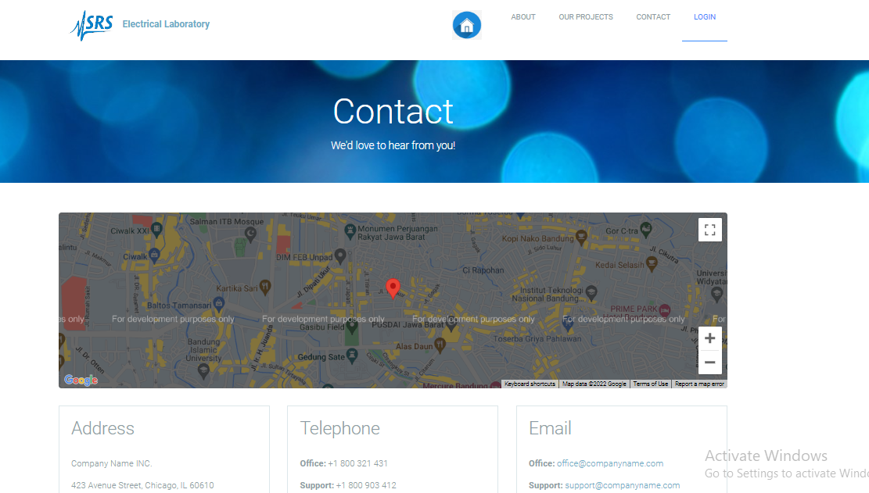
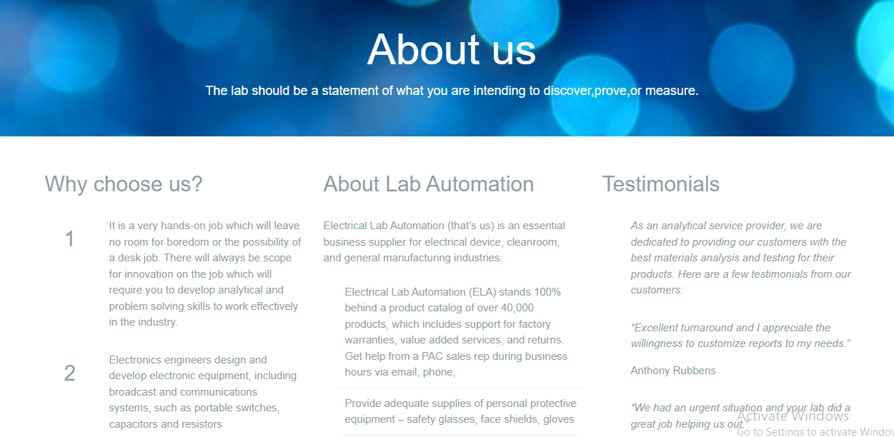

Slide 11
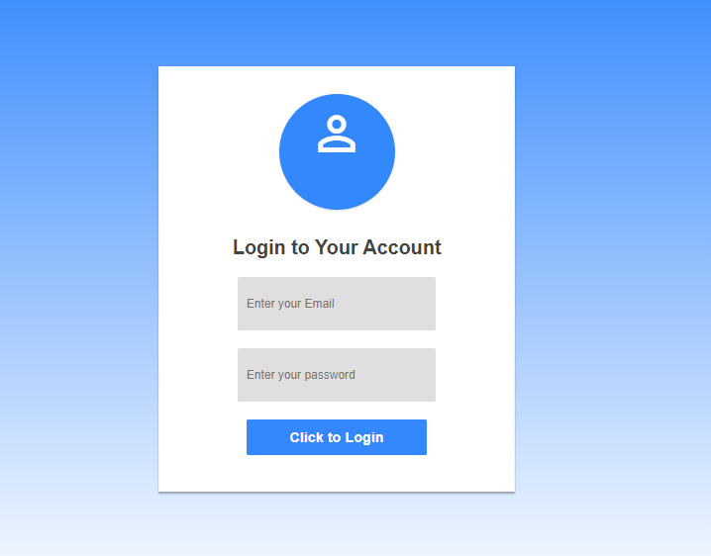
Login Tab
Here is the login tab fragment, having
an attractive visual interface.

Slide 12
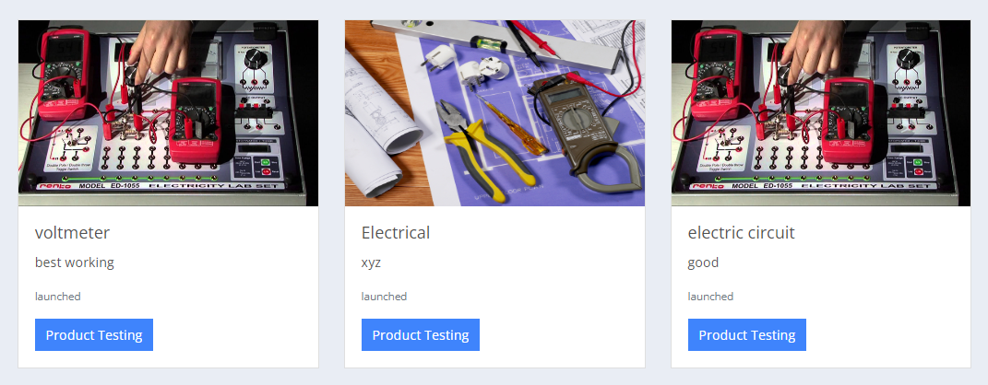
products

Slide 13
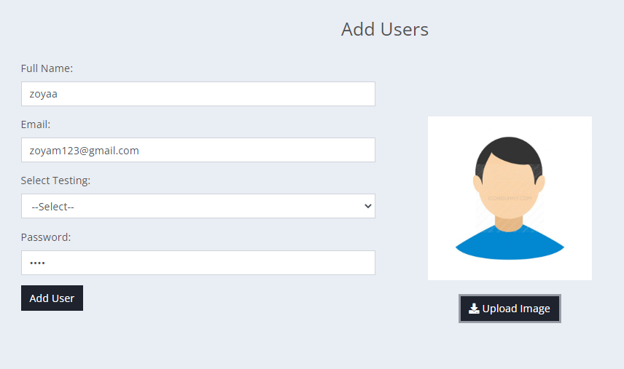
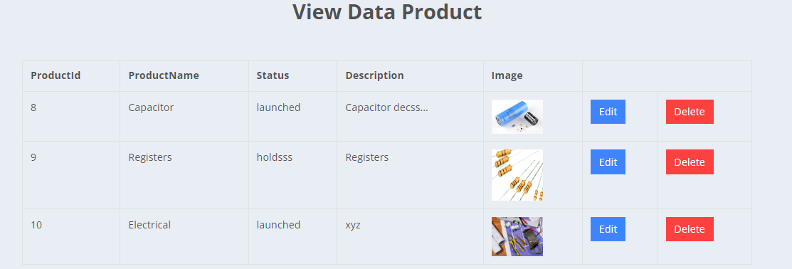
Add user form

Slide 14
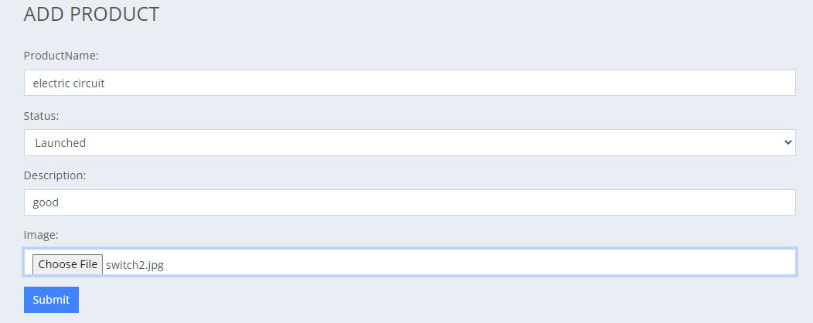
Add Product form
Here is the form by which user can
add a product which will be
shown in list of product by
category.
Add product

Slide 15
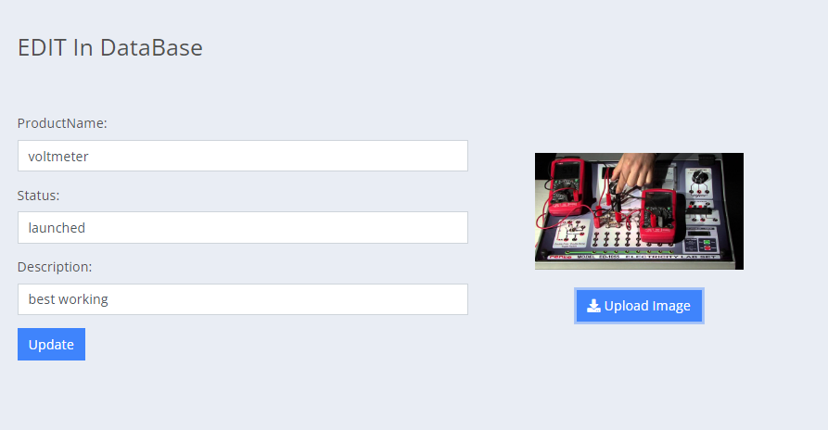
EDIT product FORM
Here is the form by which user can
edit a product. If a user switch to edit button so we have changed the product and then click on update button the product is updated.

Slide 16
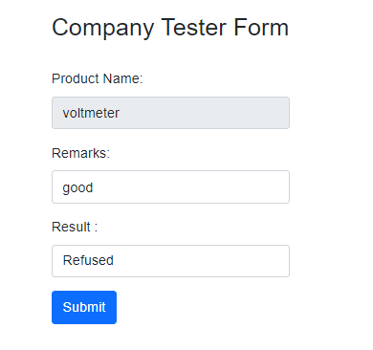
Company tester form

Slide 17
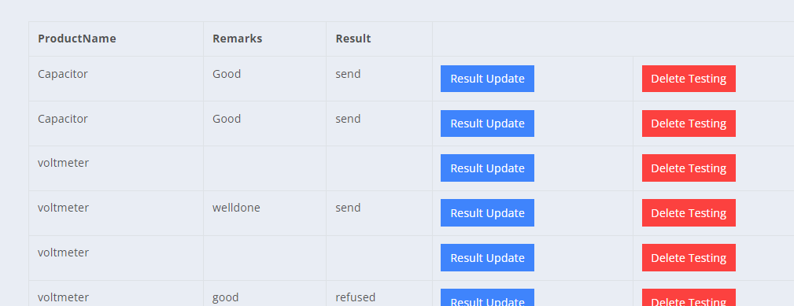
Testing products

Slide 18
Work done by
25%
25%
25%
25%
Asher Ahmed
Maryam Kashif
Company tester+ User guide
Main Website panel +Report Documentation
Zoya Abid
Zubair Uddin
Admin panel + Remaining work
Laboratory Tester + Developer guide

Slide 19
Thank you so much

